Slide 1
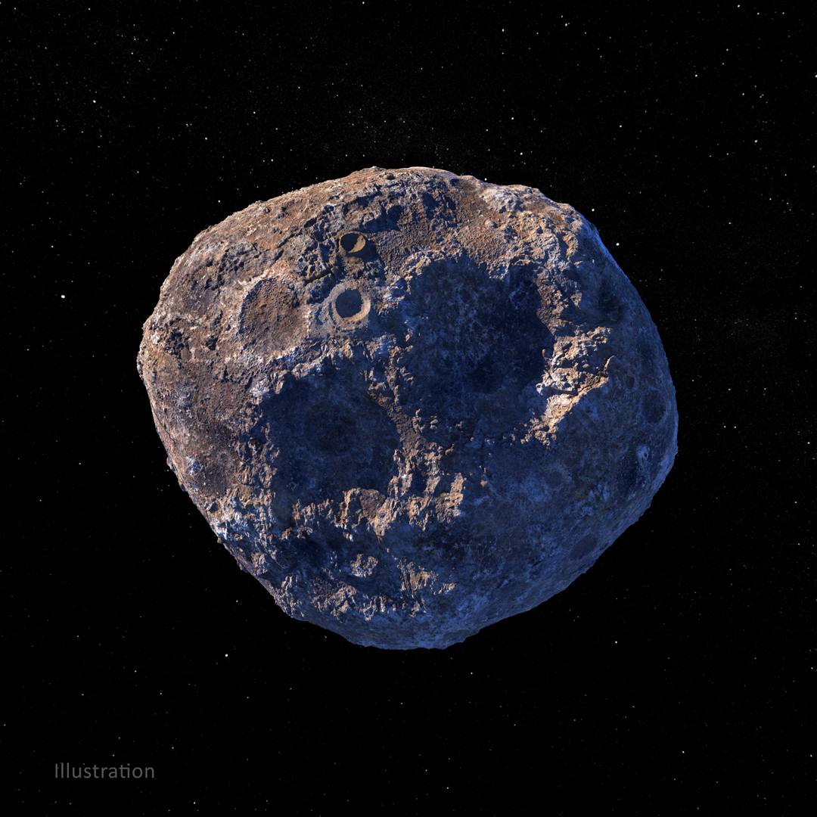
Investigating the Correlation Between Meteoroid Landing Patterns and Earth’s Geographical Features
Research Question:
How do variations in the mass and frequency of meteoroid landings influence distribution patterns?
How does the spatial variance in Earth's geographical features impact these patterns?
Image Reference: https://images.nasa.gov/details/PIA24472

Slide 2




Data Description
Method
How to Break Meteorite
Quick Guide
First, find a meteorite.
Second, jump toward it.
Third, hit it from the bottom.
Fourth, SUCCESS!
The Meteoritical Society, NASA_Meteorite Landings
Gravity and related derivative GeoTIFF grids and data
Global Horizontal Irradiance (Multiyear annual and monthly averages)
Point Pattern Analysis (only with LANDINGS data)
Kernel Density with Intensity Function
Average Nearest Neighbor
Circular KNN with Correlogram
GWR (LANDINGS data with Gravity & Radiation tif)
Correlation : occurrence ~ gravity_norm + radiation_norm
Prediction: location with highest occurrence, 30 yrs

Slide 3
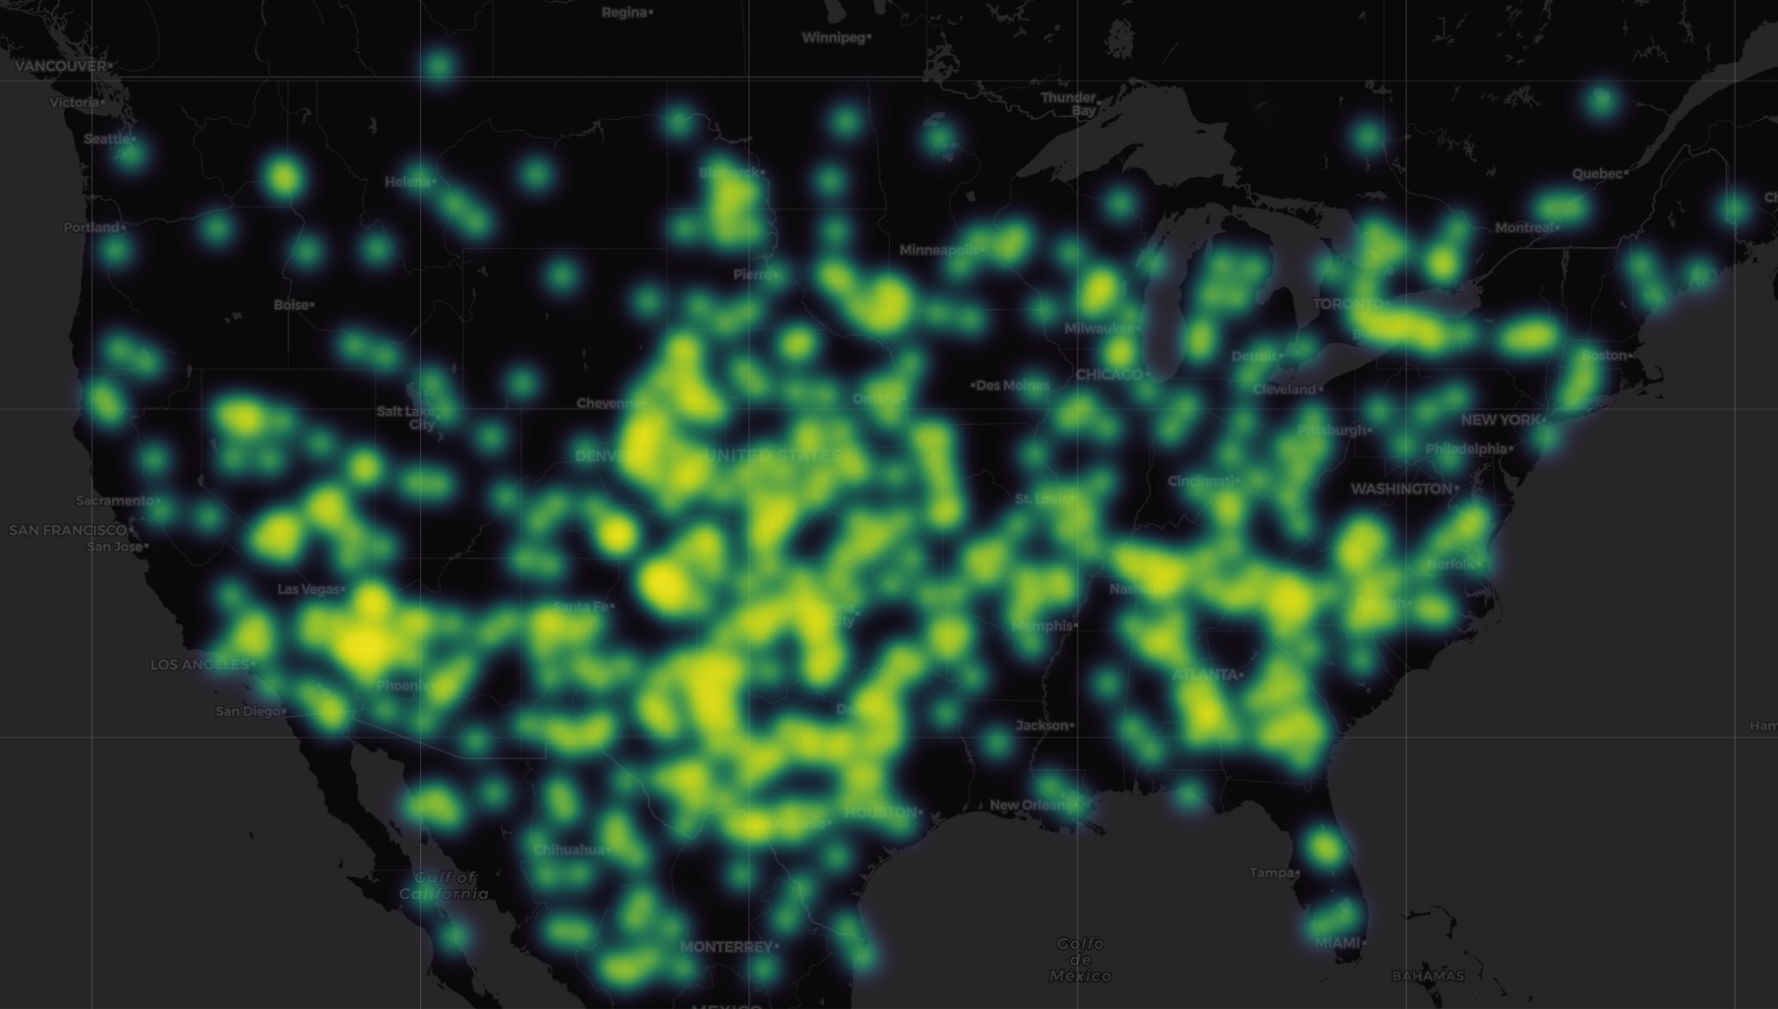
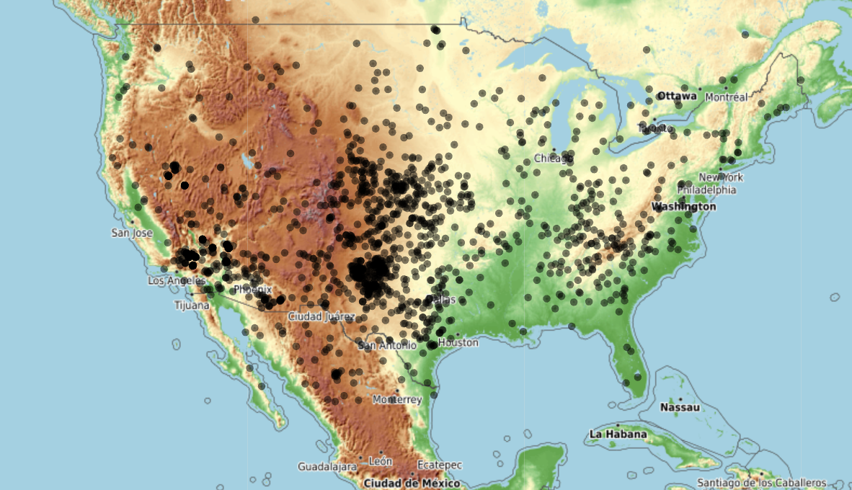
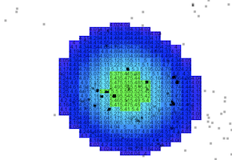
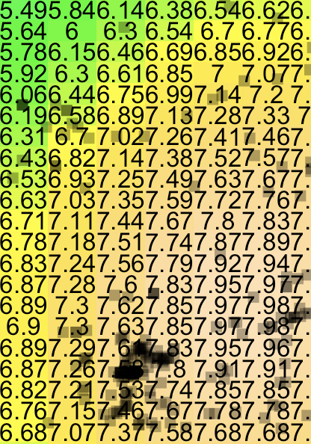
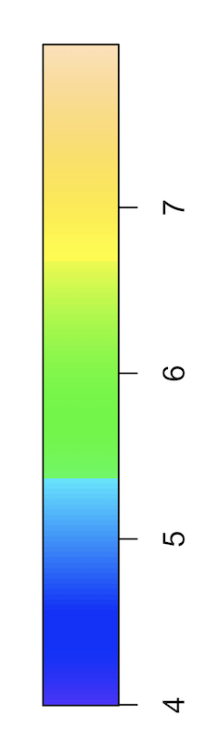
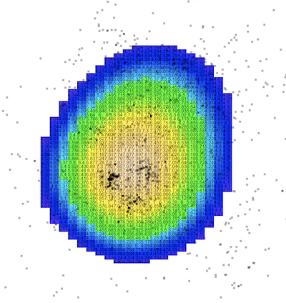
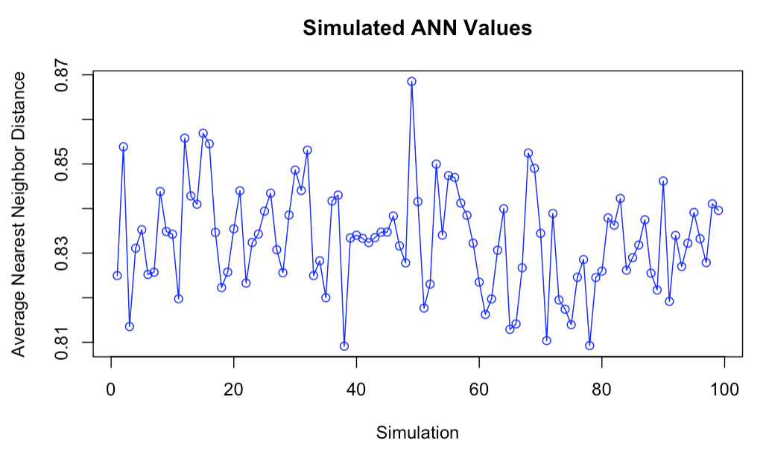
Point Pattern Analysis
Meteoroid Landings Heatmap
Meteorite Landings Overview
Mean Observed Nearest Neighbor Distance:
0.243
Mean Sim NN Distance:
0.235
P Value < 0.0001
The pattern may be consistent with a random distribution, and it is statistically significant.
Kernel Density Function Matrix
Zoom In

Slide 4
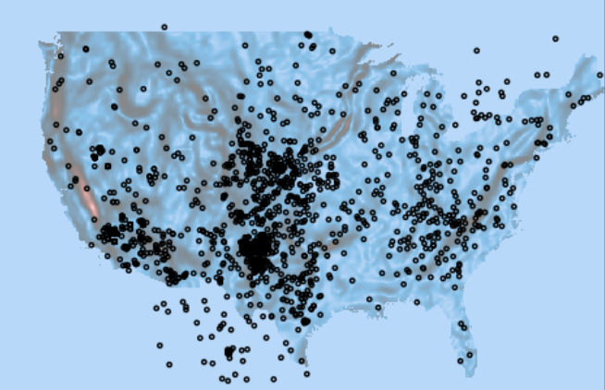
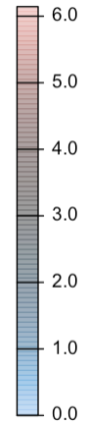
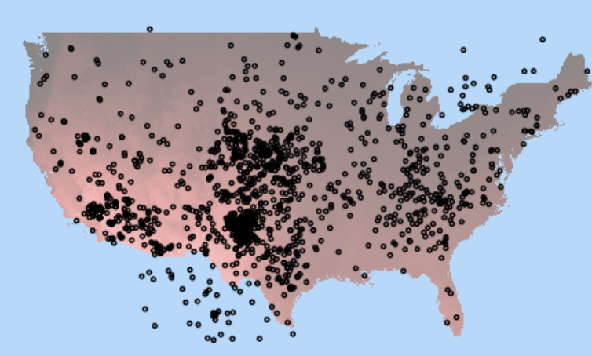
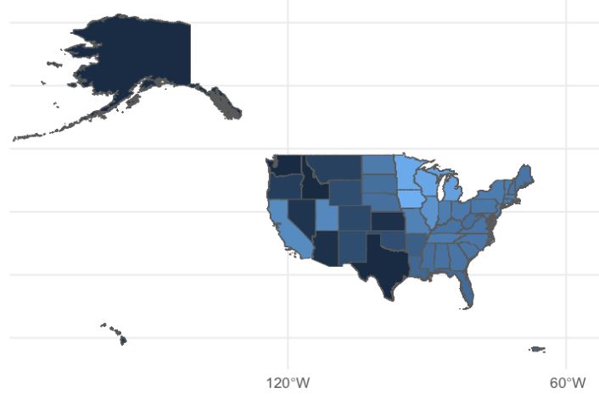
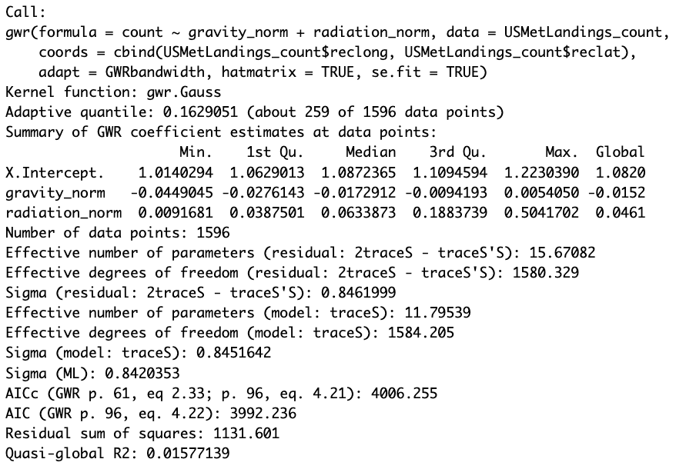
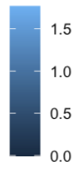
GWR
Gravity
Overview
There might be some other features influencing the landing locations.
Solar Radiation
Gravity
Local Moran's I

Slide 5
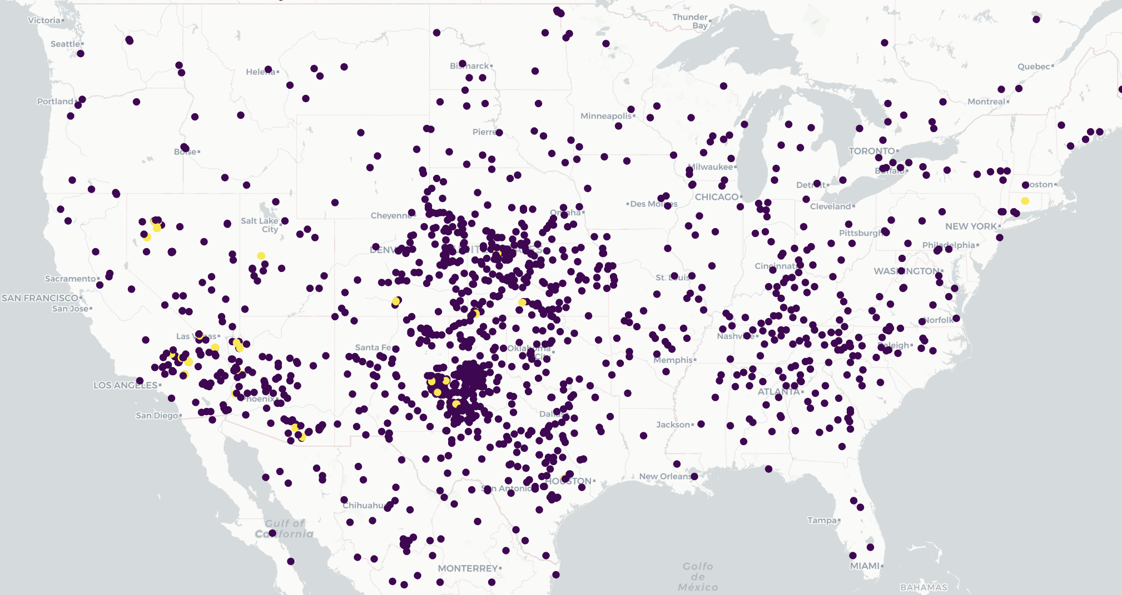
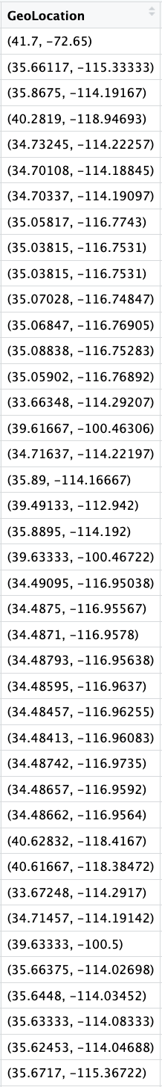
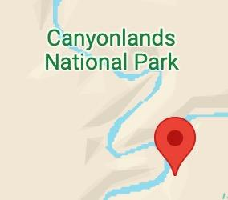
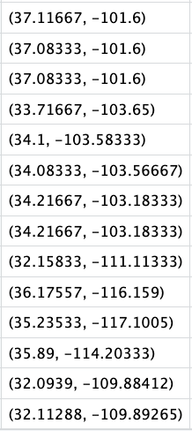
Prediction
Mass_g: 10151840

